Slide 1
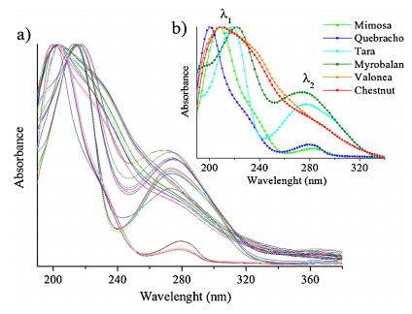
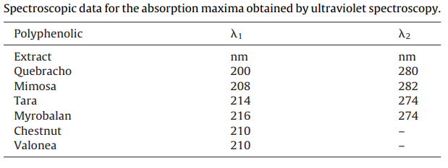
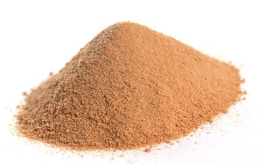
Ultraviolet spectroscopy and chemometrics for the identification of vegetable tannins
Objective
Rank 6 different extract of tannins using UV-S (absorption spectra) comparing wavelength to absorbance.
samples
Six of the most commonly used industrial tannin extracts were investigated. For condensed tannins (10 mimosa, 8 quebracho) and hydrolysable tannins (8 tara, 9 chestnut, 7 myrobalan, 5 valonea.
No pre-treatment is applied
Resultant data
The vegetable tannin extracts absorb at lower wavelengths compared with other smaller molecules.
Uv-s proved useful in the differentiation of the extracts, as it provided information on the main absorption bands, which are related to chemical composition and structure.

